Slide 1
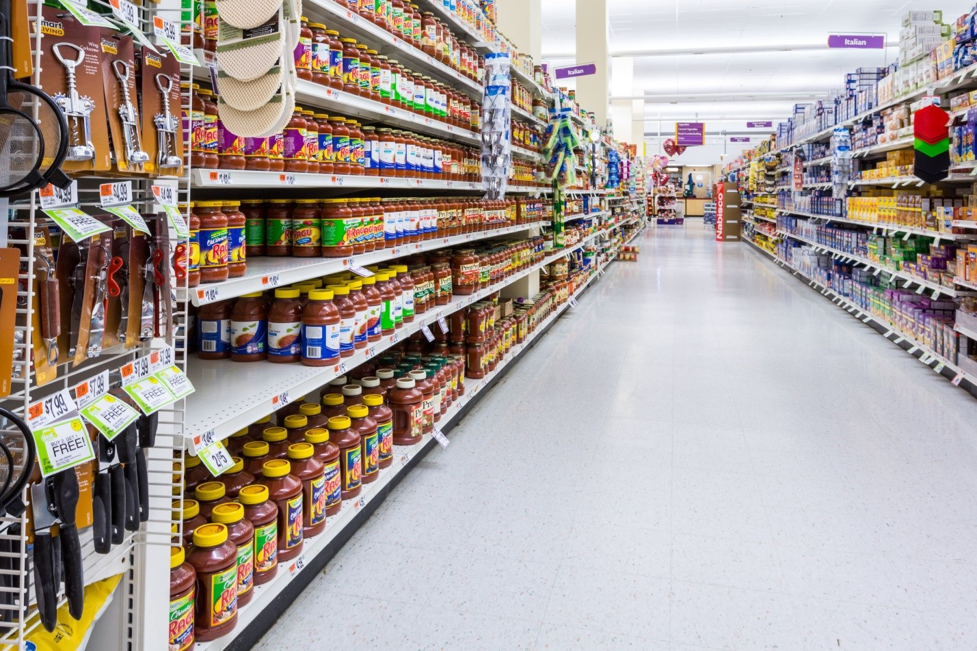
SMART RETAIL
SOLUTIONS
LIMITED
Recommendation
system

Slide 2
Problem Statement
A retail company aims to:
Implement a Customer Segmentation & Recommendation System using Machine Learning (ML) techniques.
Divide its customer base into distinct segments based on their purchasing behavior and preferences.
Develop a recommendation system that provides personalized product recommendations to customers within each segment

Slide 3


Business Questions
How can customer segmentation techniques (clustering algorithms) effectively divide the customer base into distinct segments?
What are the characteristics and preferences of each customer segment, and how do they differ?
How can User-based collaborative Filtering and Content based Filtering be integrated to provide more accurate and diverse recommendations to a customer?
How can the recommendation system address the cold start problem for new users or items with limited interaction history?

Slide 4
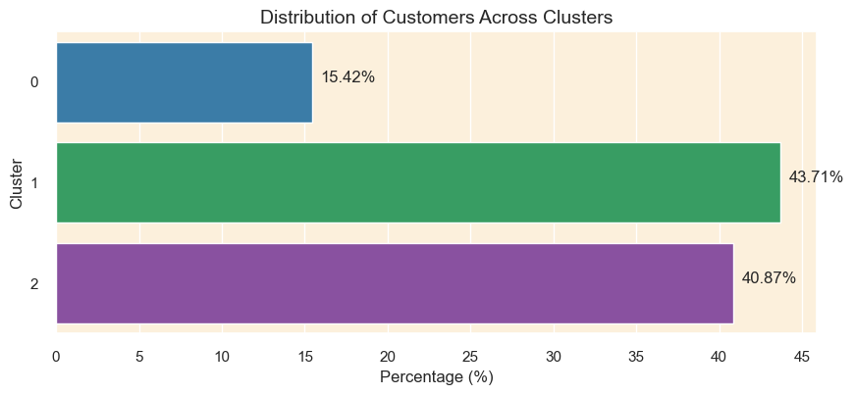


Cluster Distribution
Cluster 1 has the highest distribution of customers at 43.71%
Cluster 0 has the lowest percentage of customers at 15.42%

Slide 5

Customer Segments Behaviors
First Customer Segment
“Early Bird Shoppers”
Second Customer Segment
“Occasional Big spenders”
Third Customer Segment
“Casual Weekend Shoppers”
High spending habits on wide array of products
Shop during early hours of the day
High Fluctuations in their monthly spending
Less frequent shoppers
Biggest spenders
Shop later in the Day
They make large Purchases
Lowest spenders
Less Frequent spenders
Preference of shopping over the weekend
Low fluctuations in their Monthly spending
Least spending per Transactions

Slide 6
Recommender System
User based Collaborative Filtering
(Frequently Bought Products)
Cluster 0 Recommendations:
1. REGENCY CAKESTAND 3 TIER
2. WHITE HANGING HEART T-LIGHT HOLDER
3. JUMBO BAG RED RETROSPOT
Cluster 1 Recommendations:
1. WHITE HANGING HEART T-LIGHT HOLDER
2. REGENCY CAKESTAND 3 TIER
3. PARTY BUNTING
Cluster 2 Recommendations:
1. WHITE HANGING HEART T-LIGHT HOLDER
2. REGENCY CAKESTAND 3 TIER
3. ASSORTED COLOUR BIRD ORNAMENT

Slide 7
Recommender System
Content based Filtering
(Based on Items bought)
User 12353.0 bought the following item(s):
NOVELTY BISCUITS CAKE STAND 3 TIER
MINI CAKE STAND WITH HANGING CAKES
CERAMIC CAKE STAND + HANGING CAKES
CERAMIC CAKE BOWL + HANGING
Recommendations for User 12353.0
SWEETHEART CERAMIC TRINKET BOX
RED HANGING HEART T-LIGHT HOLDER
HANGING HEART MIRROR DECORATION
MINI CAKE STAND T-LIGHT HOLDER
ASSORTED COLOUR METAL CAT

Slide 8
Recommender System
COLD START PROBLEM
Recommendations based of geographic Location:
Top Products Recommendations for Customers from the UK:
1. WHITE HANGING HEART T-LIGHT HOLDER
2. REGENCY CAKESTAND 3 TIER
3. PARTY BUNTING
4. ASSORTED COLOUR BIRD ORNAMENT
5. SET OF 3 CAKE TINS PANTRY DESIGN
6. JUMBO BAG RED RETROSPOT
7. NATURAL SLATE HEART CHALKBOARD
8. JAM MAKING SET WITH JARS
9. SET OF 6 SPICE TINS PANTRY DESIGN
10. PACK OF 72 RETROSPOT CAKE CASES

Slide 9
Recommender System
COLD START PROBLEM
Recommendations based of geographic Location:
Top Products Recommendations for Customers not from the UK:
1. POSTAGE
2. ROUND SNACK BOXES SET OF4 WOODLAND
3. PLASTERS IN TIN CIRCUS PARADE
4. ROUND SNACK BOXES SET OF 4 FRUITS
5. REGENCY CAKESTAND 3 TIER
6. SPACEBOY LUNCH BOX
7. PLASTERS IN TIN SPACEBOY
8. RED TOADSTOOL LED NIGHT LIGHT
9. PLASTERS IN TIN WOODLAND ANIMALS
10. LUNCH BAG WOODLAND

Slide 10
Conclusion
1. Effective Segmentation: The 3 different customer segments have different item preferences.
2. Feature Engineering: The use of RFM(Recency, Frequency and Monetary) allowed us to establish customer behavior and preferences.
3. Recommendation System: The developed recommendation system, provides personalized recommendations tailored to the preferences of individual customer segments.
4. Cold Start: The Model used demographic information for initial recommendations for users who have not yet interacted with the system. Customers from UK and those not from the UK have different item preferences.

Slide 11
Recommendations
Evaluation Metrics: Evaluate the performance of the segmentation and recommendation system after collecting more customer data and item descriptions
2.Cold Start Problem: Asking for more personalized information about the users as they register on the system such as age and gender, to give new customers more tailored recommendations.
3.Feedback Mechanism: Implement a feedback mechanism to collect customer reviews for further analysis and improve the recommendation system

